Slide 1
Chemicals and Facilities View Modification
// NoComment
Lindsey, Cassandra, Warren, Arielle, Beau, and Brittany

Slide 2

Why fix this part of SOAP?
End user will be able to decide what amount of information they want to see
Spread awareness to people of all levels of understanding
Information will be made more readable and understandable
Information contained on the same page instead of redirecting
Cleaner UI through manipulation of css
Incorporate a visual aspect to the chemical data
Notes:
Cassandra

Slide 3
Objectives of the Project
Eliminate the need for the user to need to navigate to a different page in order to get more detailed information on a facility or chemical.
Create and easier method to view the data
Have different views based on the knowledge of the user
Basic and advanced views
Chemicals and facilities
Integrate pie charts of chemical use at each facilities
Notes:
Cassandra

Slide 4
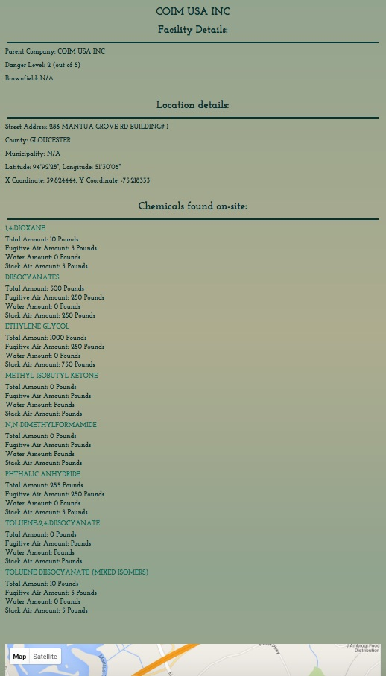
Before
Facilities page
Notes:
Warren.

Slide 5
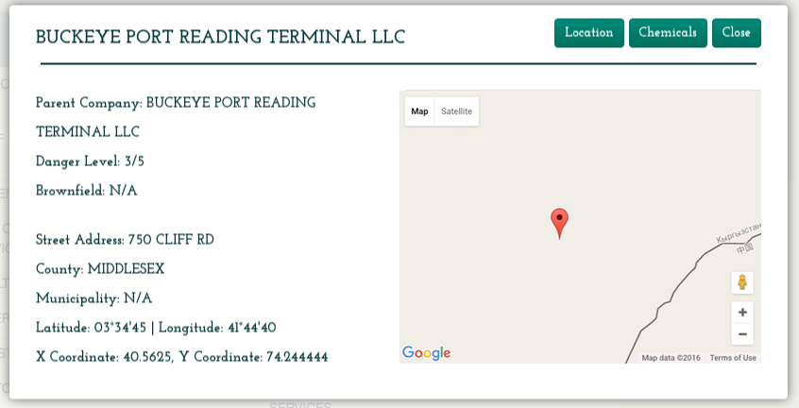

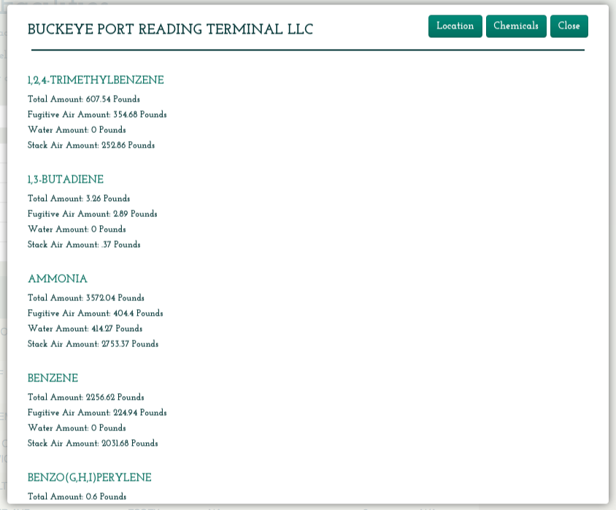
Now
Facilities page
Notes:
Warren.

Slide 6
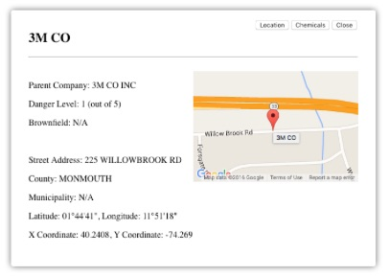
Prototype vs. Actual
Facilities page
Notes:
Warren.

Slide 7
Something new...
CSS (Bootstrap)
Google API
Facilities page
Notes:
Warren.

Slide 8
Experience of working on the project
First big collaborative project
Learning how to work with a preexisting system
New languages
Consistent coding format
Interpreting existing code
Challenges
Working separately on the same parts
Learning how the system works in order to update it
Notes:
Arielle

Slide 9

Insights Gained through the experience
How to work with other editors
How to construct solid html and improve style and formatting through css
Incorporating with javascript and php
How to use Github to manage updates and changes to a system
Making a system that is readable and intuitive
Eight golden rules
Consistency with existing modules
Modularity and cohesion
Notes:
Arielle

Slide 10
Demonstration of the system
http://csc415-team04.tcnj.edu/cabect/SOAP
Navigate to the chemicals page or the facilities page to see the improvements we made to the original system
Our Project
Chemical and facilities popup
Pie charts
Basic and advanced views
Notes:
Lindsey

Slide 11


